Slide 1
English For
Computer Science
Chapter 12 Multimedia

Slide 2
12.1 Multimedia
New Words & Expressions:
audio sound n.声音 retention n. 保留，保持
static image 静态图像 aid v. 援助，帮助
animation n. 动画 full-motion video 全运动影像
Abbreviations:
MIDI (Musical Instrument Digital Interface) 乐器数字接口
计算机专业英语
1-<number>

Slide 3
12.1 Multimedia
Multimedia Equipment
Multimedia requires sound and graphics capability.
A speedy processor chip plus a CD-ROM drive or DVD drive are also desirable. Today, multimedia components are standard equipment even on many inexpensive computers.
多媒体设备
多媒体需要声音和图形功能。
还需要一个快速的处理器芯片再配上一个CD-ROM或DVD驱动器。现在，即使在很多廉价计算机上，多媒体部件也是作为标准设备。
计算机专业英语
1-<number>

Slide 4
12.1 Multimedia
A sound card gives a computer the capability to record and play sound files as well as video sound tracks.
Housed within the system unit, a sound card contains connectors that project from(伸出来) the back of the computer so that you can attach speakers, headphones, and a microphone.
声卡为计算机提供了录制与放映声音文件的功能，作用类似于录音带。
声卡安装在系统机箱内，它在计算机后面有一些突出的接口，可供用户将扬声器、耳机和麦克风插在上面。
计算机专业英语
1-<number>

Slide 5
12.1 Multimedia
Expensive sound cards include circuitry for special audio effects, such as 3-D sound.
The quality of your computer’s speakers and headphones can also affect the quality of the sound that you hear.
昂贵的声卡包含了支持特别音频效果的电路，如立体声。
机器配置的扬声器和耳机的质量也会影响到你听到的音质。
计算机专业英语
1-<number>

Slide 6
12.1 Multimedia
A CD-ROM drive allows your computer to access audio and software CD-ROMS. Multimedia elements-especially videos-require lots of storage space.
Rather than store huge amounts of multimedia data on a computer’s hard disk, the data can be stored on a CD-ROM, which you insert only when you want to access the multimedia elements.
CD-ROM驱动器允许计算机访问光盘内的音频和软件—特别是视频—需要大量的存储空间人们并不把大量的多媒体数据存储在电脑硬盘上，
而是存放在只读光盘上，只有需要访问多媒体数据时，才将光盘插入驱动器。
DVD-ROM, (USB)Flash Disk
计算机专业英语
1-<number>

Slide 7
12.1 Multimedia
A DVD drive can access multimedia data from CD-ROMs as well.
A DVD also allows you to watch feature-length movies on your computer.
一个DVD驱动器可以访问CD-ROM中的多媒体信息，也能让你在计算机上观赏长篇电影。
计算机专业英语
1-<number>

Slide 8
12.1 Multimedia
In motion picture terminology, feature length is the length of a feature film.
According to the rules of the Academy of Motion Picture Arts and Sciences, a feature-length motion picture must have a running time of more than 40 minutes to be eligible for an Academy Award.
A feature film is a film (also called a movie, motion picture or just film) with a running time long enough to be considered the principal or sole film to fill a program.
长篇电影是一部电影，它的运行时间足够长，可以被认为是节目中的主要或唯一影片。
计算机专业英语
1-<number>

Slide 9
12.1 Multimedia
Your computer’s graphics card takes signals from the processor and uses them to “paint” an image on the screen.
A graphics card is installed inside the computer’s system unit and provides a connection for the monitor’s data cable. Your computer’s graphics card has to do a lot of work and must do it quickly.
计算机的图形卡（显卡）接收来自处理器的信号，并在屏幕上画出图形。
图形卡安装在机器的机箱内，并提供显示器的数据电缆的接口。计算机的图形卡需要快速的做大量工作。
display card/graphics card/display adapter /graphics adapter
计算机专业英语
1-<number>

Slide 10
12.1 Multimedia
To display videos, for example, it repaints every pixel on the screen 15 times per second.
More expensive “accelerated” graphics cards are equipped with circuitry that optimizes such tasks.
比如，为了显示视频，每个像素每秒必须重画15次。
为了优化此类工作，电路需安装更昂贵的加速图形卡。
计算机专业英语
1-<number>

Slide 11
12.1 Multimedia
A fast processor can quickly handle the huge amount of digital data that is required to store and produce multimedia.
The faster the processor, the more data it can process each second.
一个快速处理器能快速处理需要存储并生成多媒体的大量数字数据。
处理器越快，每秒处理的数据越多。
计算机专业英语
1-<number>

Slide 12
12.1 Multimedia
A computer with a fast processor outputs smooth video sequences with a sound track that is perfectly coordinated with(协调) the action.
The popularity of multimedia has caused chipmakers to equip processor chips with special multimedia capabilities that speed up multimedia features such as sound and video.
配有快速处理器的计算机输出平滑的配有动作的声音影像。
多媒体的流行使得芯片制造商开始配置具有特殊多媒体功能的处理器芯片，以加速声音和图像等多媒体性能。
计算机专业英语
1-<number>

Slide 13
12-2 ELEMENTS OF MULTIMEDIA
New Words & Expressions:
audio sound n.声音 retention n. 保留，保持
static graphics images 静态图像 aid v. 援助，帮助
animation n. 动画 full-motion video 全运动影像
Abbreviations :
MIDI (Musical Instrument Digital Interface) 乐器数字接口
计算机专业英语
1-<number>

Slide 14
12-2 ELEMENTS OF MULTIMEDIA
We break the word multimedia into its component parts, we get multi -meaning more than one ,and media-meaning form of communication. Those types of media include:
Text，Audio Sound，Static Images，Animation，Full-Motion Video，Graphic
如果我们把multimedia这个词分开，我们便得到multi-多，和media-媒体。媒体类型包括：
文本，声音，静态图像，动画，动态视频
计算机专业英语
1-<number>

Slide 15
12-2 ELEMENTS OF MULTIMEDIA
All of the Above
You can see that multimedia is by no means just one of the preceding technologies.
Because of what hardware can and cannot do, it is often a trade-off between a certain number of static graphics images, audio sound, full-motion video and text.
As you may guess, textual information takes the least amount of space to store.
总结：显然多媒体决不是一种从前的技术，由于硬件的能力要权衡选择静态图像、声音、全运动影像和文本，可以推测，文本信息占用存储空间最小。
计算机专业英语
1-<number>

Slide 16
12-2 ELEMENTS OF MULTIMEDIA
Even if a multimedia machine had unlimited resources, you would still want to add a combination of these multimedia technologies.
For example, although a picture is worth a thousand words, it would be difficult to portray the work of William Shakespeare through pictures only. The same goes for audio sound.
即使多媒体机有无限的资源，人们仍想增加融这些多媒体技术于一体的综合技术。
例如，尽管“一图胜千言”，但仍难以只用图像表述完莎士比亚的著作，仅用声音当然也不行。
计算机专业英语
1-<number>

Slide 17
12-2 ELEMENTS OF MULTIMEDIA
You could record the sound of church bells and a narration of the Bible, but at times you would rather have the Bible in textual format, which would allow you to search for certain key words.
你可以记录教堂的钟声和圣经的叙述，但你仍愿使用文本形式的圣经，因为它可以使你查找某些关键词。
计算机专业英语
1-<number>

Slide 18
12.3 The Multimedia Personal Computer
New Words & Expressions
business strength 具有事务处理能力的 chore n. 家务杂事
arcade 带拱顶街道 unleash v. 释放
playback v. 重播，读出 synthesizer n. 综合器，合成器
mixer n.混合者，搅拌器 thru port n. 吞吐量
buzzword n. 时髦词语，漂亮口号 jargon n. 行话，术语
frame n. 帧 jerky a. 急拉的，急动的
Abbreviations:
MPC (Multimedia Personal Computer) 多媒体个人计算机
CD-ROM (Compact Disc-Read Only Memory) 光盘只读存储器
MIDI (Musical Instrument Digital Interface) 乐器数字接口
计算机专业英语
1-<number>

Slide 19
12.3 The Multimedia Personal Computer
What is MPC?
MPC stands for “multimedia personal computer”.
The requirements for an MPC are described in detail in Microsoft’s Multimedia PC Specification Version 1.0. Here are the key elements of the specification:
什么是MPC？
MPC是指“多媒体个人计算机”。
Microsoft公司的“多媒体PC机规范1.0版”一书对MPC机进行了详细描述。以下是此规范的要求：
计算机专业英语
1-<number>

Slide 20
12.3 The Multimedia Personal Computer
BASE SYSTEM: a Windows-capable system with a 10-MHz 286 or faster CPU; at least 2MB of RAM; a 30 MB or larger hard disk; a 3.5-inch 1.44 MB floppy drive; a 101-key keyboard; a two-button mouse; and parallel, serial, and joystick ports.
基本系统：一个能运行Windows的系统。它采用10MHz时钟的286或速度更快的CPU；至少有2兆字节的RAM；30兆字节或更大的硬盘空间；3.5英寸1.44兆字节的软盘驱动器；101键盘；两按钮的鼠标器以及并行、串行的控制杆端口。
计算机专业英语
1-<number>

Slide 21
12.3 The Multimedia Personal Computer
VIDEO: standard VGA is all that’s required; （DVI, HDMI）
CD-ROM: a CD-ROM drive that transfers at least 150 K of data per second without taking up more than 40 percent of the CPU’s attention, play CD audio, and has an average access time of 1 second or less. (DVD-ROM, Flash Disk)
视频：标准的VGA显示器即可。
CD-ROM：要求CD-ROM光驱的数据传输速率至少为每秒150 K，不能占用40%以上的CPU时间，能播放CD，平均存取时间为1秒或更短。
计算机专业英语
1-<number>

Slide 22
12.3 The Multimedia Personal Computer
AUDIO: a sound board with 8-bit, 11.025-kHz sampling and 22.05-kHz playback; a synthesizer capable of playing eight notes simultaneously using five different sounds; a mixer to combine CD audio, sampling, and synth; a microphone input; and MIDI in, out, and thruports.
音频功能：一块8位的、11.025kHz取样和22.05kHz回放的声卡；能同时放8个使用5种不同音色的音律的合成器；能把光盘音频、取样和合成声音混合起来的混声器；麦克风输入；MIDI（乐器数字接口）输入、输出和通路。
计算机专业英语
1-<number>

Slide 23
12.3 The Multimedia Personal Computer
Every new technology has its own buzzwords, and sorting them out can be real detective work. The following is two jargons of MPC.
FULL-MOTION VIDEO: Full-motion video is digitally recorded video played back at the broadcast standard of 30 frames per second, or close enough to that speed so the video appears smooth rather than jerky.
每一种新技术都有它自己的术语，将它们进行分类是一项非常精细的工作，下面是MPC的两个术语。
全运动图像：全运动图像是以数字方式记录的视频图像，以每秒30帧的电视广播标准或者非常接近于此的速度重现图像，因而这些视频图像看上去很自然，没有跳跃感。
计算机专业英语
1-<number>

Slide 24
12.3 The Multimedia Personal Computer
MIDI: MIDI is short for Musical Instrument Digital Interface, a standard specification developed by music synthesizer manufacturers.
The concept of being able to control several instruments from one keyboard has grown into a method for putting musical instruments, tape recorders, VCRs, mixers, and even stage-lighting under the control of a single computer.
MIDI：MIDI是乐器数字接口的缩写。它是由音乐合成器制造商开发的标准规范。
从一个键盘能控制几个乐器的想法已变为现实，它能把乐器、磁带录音机、录像机、混声器、甚至舞台灯光等置于单台计算机的控制之下。
计算机专业英语
1-<number>

Slide 25
选择相应的英文单词
frame media dialogue compress demo
clip text microphone bitmap manner
(1) text : Data that consists of characters representing the words and symbols of humna speech; usually, character coded according to the ASCII standard, which assigns numeric values to numbers, letters, and certain symbols.
(2) media : The physical matrerial, such as paper, disk, and tape, used for storing computer-based information.
(3) bitmap : A data structure in memory that represents information in the form of a collection of individual bits.
(4) compress: To reduce the size of a set of data, such as a file or a communications message, so that it can be stored in less space or transmitted with less bandwidth.
(5) clip : A short extract from a film or videotape.
(6) microphone : An instrument that coverts sound waves into an electric current, ususlly fed into an amplifier, a recorder, or a broadcast transmitter.
计算机专业英语
1-<number>

Slide 26
选择相应的英文单词
frame media dialogue compress demo
clip text microphone bitmap manner
(1) text : Data that consists of characters representing the words and symbols of humna speech; usually, character coded according to the ASCII standard, which assigns numeric values to numbers, letters, and certain symbols.
(2) media : The physical matrerial, such as paper, disk, and tape, used for storing computer-based information.
(3) bitmap : A data structure in memory that represents information in the form of a collection of individual bits.
(4) compress : To reduce the size of a set of data, such as a file or a communications message, so that it can be stored in less space or transmitted with less bandwidth.
(5) clip : A short extract from a film or videotape.
(6) microphone : An instrument that coverts sound waves into an electric current, ususlly fed into an amplifier, a recorder, or a broadcast transmitter.
计算机专业英语
1-<number>

Slide 27
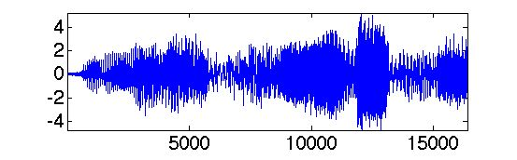
Audio
An audio signal is a representation of sound, typically as an electrical voltage.
Audio signals have frequencies in the audio frequency range of roughly 20 to 20,000 Hz (the limits of human hearing).
音频
音频信号是声音的一种表示方式，一般表示为一种电压。
音频信号的音频频率范围大概从20赫兹到20,000赫兹（人类听觉的极限）。
计算机专业英语
1-<number>

Slide 28
Audio
Audio signals may be synthesized directly, or may originate at a transducer such as a microphone, musical instrument pickup, phonograph cartridge, or tape head.
Loudspeakers or headphones convert an electrical audio signal into sound. Digital representations of audio signals exist in a variety of formats.
音频信号可以直接地人工合成，或者通过如麦克风，乐器拾音器，留声机拾音器，磁头等变频器产生。
扬声器或耳机可以把电气音频信号转换为声音。音频信号的数字表示具有多种格式。
Electrical(电气的), Electronics(电子的)
计算机专业英语
1-<number>

Slide 29
Digital audio is technology that can be used to record, store, generate, manipulate, and reproduce sound using audio signals that have been encoded in digital form.
Following significant advances in digital audio technology during the 1970s, it gradually replaced analog audio technology in many areas of sound production, sound recording (tape systems were replaced with digital recording systems), sound engineering and telecommunications in the 1990s and 2000s.
数字音频是使用已被编码成数字格式的音频信号来记录、存储、产生、操作和复制声音的一种技术。
随着数字音频技术在1970年代的巨大进步，数字音频技术从90年代到2000年代在发声、录音、音响工程和电信等众多领域逐渐取代了模拟音频技术。
计算机专业英语
1-<number>

Slide 30
A microphone converts sound to an analog electrical signal, then an analog-to-digital converter (ADC)—typically using pulse-code modulation—converts the analog signal into a digital signal.
This digital signal can then be recorded, edited and modified using digital audio tools.
麦克风把声音转换成模拟电气信号，然后模-数转换器（ADC），通常使用脉冲编码调制，把模拟信号转换成数字信号。
数字信号可使用数字音频工具进行记录、编辑和修改。
计算机专业英语
1-<number>

Slide 31
When the sound engineer wishes to listen to the recording on headphones or loudspeakers, a digital-to-analog converter performs the reverse process, converting a digital signal back into an analog signal, which analog circuits amplify and send to a loudspeaker.
当音响工程师需要听记录在耳机或扬声器的声音时，数-模转换器进行逆操作，把一个数字信号转换回模拟信号，然后模拟电路把该模拟信号增强并发送到扬声器。
计算机专业英语
1-<number>

Slide 32
Digital audio systems may include compression, storage, processing and transmission components.
Conversion to a digital format allows convenient manipulation, storage, transmission and retrieval of an audio signal.
Unlike analog audio, in which making copies of a recording leads to degradation of the signal quality, when using digital audio, an infinite number of copies can be made without any degradation of signal quality.
数字音频系统可能包括压缩、存储、处理和传输等部件。
转换成数字格式可对音频信号进行更方便的操作、存储、传输和检索。
模拟音频被复制的时候导致信号质量的降低，不同于前者，当使用数字音频时，大量复制时不会引起信号质量的降低。
计算机专业英语
1-<number>

Slide 33
Image
A digital image is a numeric representation of a two-dimensional image.
Depending on whether the image resolution is fixed, it may be of vector or raster type.
By itself, the term "digital image" usually refers to raster images or bitmapped images.
图像
数字图像是二维图像的一种数值表示。
基于图像分辨率是否是固定的，数字图像可分为矢量类型和光栅类型。
“数字图像”这个术语一般是指光栅图像或点阵图像。
计算机专业英语
1-<number>

Slide 34
Raster images have a finite set of digital values, called picture elements or pixels.
The digital image contains a fixed number of rows and columns of pixels.
Pixels are the smallest individual element in an image, holding values that represent the brightness of a given color at any specific point.
光栅图像拥有一个有限的数字取值集合，这些数字取值被称为图像元素或像素。
数字图像包含了固定数量的行像素和列像素。
像素是一幅图像中最小的单元，它的取值表示了任意一点的一个给定颜色的亮度。
计算机专业英语
1-<number>

Slide 35
Vector images resulted from mathematical geometry (vector).
In mathematical terms, a vector consists of point that has both direction and length.
Often, both raster and vector elements will be combined in one image.
矢量图像产生于数学几何的矢量。
在数学术语中，一个矢量包含了点的方向和长度。
通常地，光栅元素和矢量元素会组合用于一幅图像中。
计算机专业英语
1-<number>

Slide 36
Digital image processing
Digital image processing is the use of computer algorithms to perform image processing on digital images.
As a subcategory or field of digital signal processing, digital image processing has many advantages over analog image processing.
数字图像处理
数字图像处理使用计算机算法在数字图像上进行图像处理。
作为数字信号处理的子类或子领域，数字图像处理比模拟图像处理具备更多的优点。
计算机专业英语
1-<number>

Slide 37
Digital image processing
It allows a much wider range of algorithms to be applied to the input data and can avoid problems such as the build-up of noise and signal distortion during processing.
Since images are defined over two dimensions (perhaps more), digital image processing may be modeled in the form of multidimensional systems.
数字图像处理
它允许把更广泛的算法应用到输入数据中，能够避免在处理过程中产生的如积累噪声、信号扭曲等问题。
由于图像被定义为二维（或许更多），数字图像处理可被建模成多维系统的形式。
计算机专业英语
1-<number>

Slide 38
Video
Digital video is a representation of moving visual images in the form of encoded digital data.
This is in contrast to analog video, which represents moving visual images with analog signals.
Digital video comprises a series digital images displayed in rapid succession.
数字视频是移动视觉图像经过数字编码的表示形式。
相对于模拟视频而言，模拟视频则使用模拟信号对移动的视觉图像进行编码。
数字视频包含了一系列快速显示的数字图像。
计算机专业英语
1-<number>

Slide 39
Video
In contrast, one of the key analog video methods, motion picture film, uses a series of photographs which are projected in rapid succession.
Standard film stocks such as 16 mm and 35 mm record at 24 frames per second.
For video, there are two frame rate standards: NTSC, at about 30 frames per second, and PAL at 25 frames per second.
相对而言，模拟视频中的一种关键方法，电影胶片，使用了一系列快速投影的图片。
标准的电影胶片备有如16mm和35mm的，每秒包含24帧。
对于视频，有两种主要的帧率标准：NTSC，每秒约30帧，PAL，每秒25帧。
计算机专业英语
1-<number>

Slide 40
Encoding 编码
All current formats (ISO, ITU), which are listed below, are PCM based.
MPEG-1 used for video CDs
MPEG-2 used for DVDs, Super-VCDs, and many broadcast television formats
MPEG-4 good for online distribution of large videos and video recorded to flash memory
H.261
H.262 (MPEG-2)
H.263
H.264 also known as MPEG-4 Part 10, or as AVC, used for Blu-ray Discs and some broadcast television formats
H.265
计算机专业英语
1-<number>

Slide 41
Sampling
In signal processing, sampling is the reduction of a continuous signal to a discrete signal.
A common example is the conversion of a sound wave (a continuous signal) to a sequence of samples (a discrete-time signal).
采样
在信号处理中，采样是把一个连续信号简化成一个离散信号的过程。一个简单的例子是把一个声波（连续信号）转换成一系列的采样值（离散信号）。
计算机专业英语
1-<number>

Slide 42
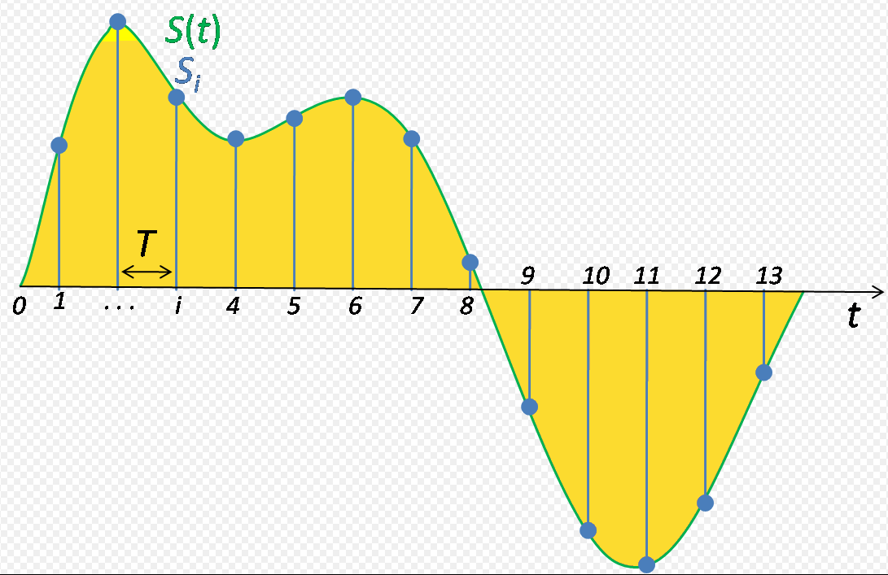
Nyquist-Shannon sampling theorem
Signal sampling representation. The continuous signal is represented with a green colored line while the discrete samples are indicated by the blue vertical lines.
计算机专业英语
1-<number>

Slide 43
Nyquist-Shannon sampling theorem
The theorem states that, when converting from an analog signal to digital (or otherwise sampling a signal at discrete intervals), the sampling frequency must be greater than twice the highest frequency of the input signal in order to be able to reconstruct the original perfectly from the sampled version.
计算机专业英语
1-<number>

Slide 44
Quantization is the process of mapping a large set of input values to a (countable) smaller set.
Rounding and truncation are typical examples of quantization processes.
Quantization forms the core of essentially all lossy compression algorithms.
量化是把一个大集合的输入值映射到一个（可数的）小集合的过程。
舍入和截断是量化过程的两种典型例子。
量化是有损压缩算法的基本核心。
计算机专业英语
1-<number>

Slide 45
The difference between an input value and its quantized value (such as round-off error) is referred to as quantization error.
A device or algorithmic function that performs quantization is called a quantizer.
An analog-to-digital converter is an example of a quantizer.
输入值和它的量化值的差值为量化误差。
能够进行量化操作的设备或是算法被称为量化器。
一个模拟-数字转换器就是量化器的一种。
计算机专业英语
1-<number>

Slide 46
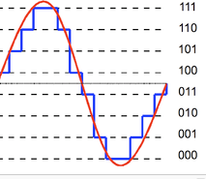
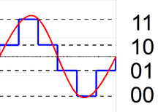
2-bit resolution with four levels of quantization compared to analog.
3-bit resolution with eight levels.
计算机专业英语
1-<number>

Slide 47
Filter/Filtering
A filter is a device or process that removes some unwanted components or features from a signal.
Filtering is a class of signal processing, the defining feature of filters being the complete or partial suppression of some aspect of the signal.
滤波器/滤波
滤波器是把一些不需要的成分或特征从一个信号中去除的设备或过程。
滤波是信号处理的一类，滤波器中定义特征是对信号的某些方面进行完全或部分的抑制。
计算机专业英语
1-<number>

Slide 48
Filter/Filtering
The frequency response filtering can be classified into a number of different bandforms describing which frequency bands the filter passes (the passband) and which it rejects (the stopband):
频率响应滤波可被分为一系列不同的带宽形式，这些带宽形式描述了滤波器能通过哪些频率带宽（通过带宽）和阻止哪些频率带宽（停止带宽）。
计算机专业英语
1-<number>

Slide 49
Filter/Filtering
Low-pass filter: low frequencies are passed, high frequencies are attenuated.
High-pass filter: high frequencies are passed, low frequencies are attenuated.
Band-pass filter: only frequencies in a frequency band are passed.
Band-stop filter or band-reject filter: only frequencies in a frequency band are attenuated.
低通滤波:低频通过，高频减弱。
高通滤波:高频通过，低频减弱。
带通滤波:指定频段的频率通过。
带阻滤波:指定频段的频率减弱。
计算机专业英语
1-<number>

Slide 50
Fill in the blanks
Types of databases: flat database ， hierarchical database , relational database ,
network database , and EAV database .
There are four kinds of threats to the security of a computing
system : interruption ， interception , modification , and fabrication .
Two main cryptography schemes: symmetric system and asymmetric system .
Key elements of a scientific research paper: Title , Abstract ,
Introduction , Proposed Method , Experimental results , Disscussions ，
Conclusions , and Reference .
计算机专业英语
1-<number>

Slide 51
Translations
在密码学里，公钥基础设施是一种把公钥和实体身份进行绑定的一种约定。绑定是使用认证中心进行证书注册、证书发放的过程。基于绑定的确保等级，这个过程可以是一个自动的过程，也可以在人类监督下进行。
In cryptography,a PKI is an arrangement that binds public keys with respective identities of entities.The Binding is established through a process of registration and issuance of certificates at and by a certificate authority(CA).Depending on the assurance level of the binding,this may be carried out by an automated process or under human supervision.
计算机专业英语
1-<number>

